Slide 1
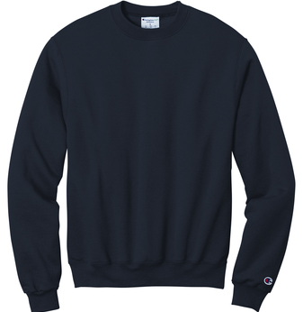
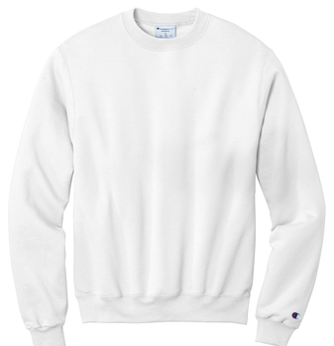
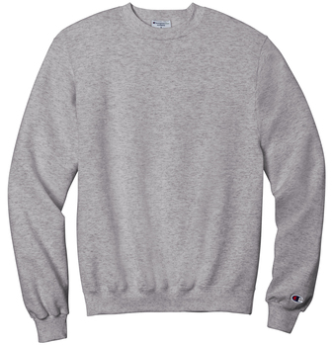
Norcross Spiritwear Order Form 2023- Items will be printed with the Norcross Soccer logo in white or navy depending on the garment color
Champion® Powerblend® Crewneck Unisex Sweatshirt- $28.50 each S-XL, $30.50- 2XL and $31.50- 3XL
9-ounce, 50/50 cotton/poly
Double Dry technology wicks moisture
1x1 rib knit sleeve cuffs and hem
Embroidered Champion “C” logo at left cuff
Woven back neck label
Color: ____ Navy ____ Light Steel ____ White
Size: ____ S ____ M ____ L ____ XL ___ 2XL ____ 3XL

Slide 2
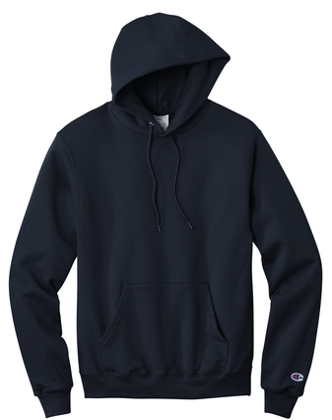
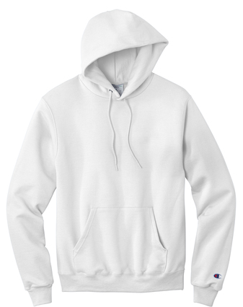
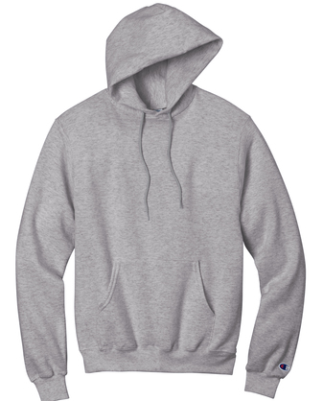
Norcross Spiritwear Order Form 2023- Items will be printed with the Norcross Soccer logo in white or navy depending on the garment color
Champion® Powerblend® Unisex Pullover Hoodie- $36.50 each S-XL, $38.50- 2XL and $40.50- 3XL
9-ounce, 50/50 cotton/poly
Double Dry technology wicks moisture
1x1 rib knit sleeve cuffs and hem
Front Pouch Pocket
Embroidered Champion “C” logo at left cuff
Woven back neck label
Color: ____ Navy ____ Light Steel ____ White
Size: ____ S ____ M ____ L ____ XL ___ 2XL ____ 3XL

Slide 3
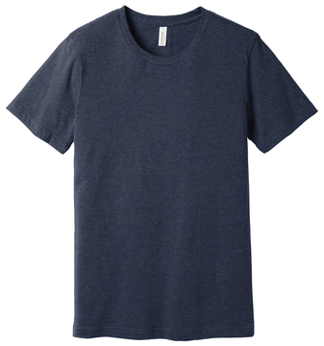
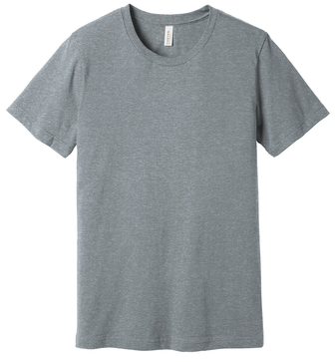
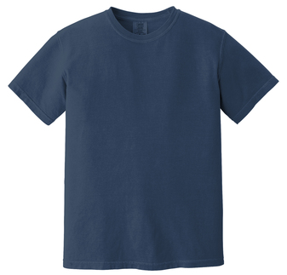
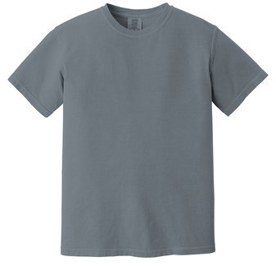
Norcross Spiritwear Order Form 2023- Items will be printed with the Norcross Soccer logo in white or navy depending on the garment color
BELLA+CANVAS ® Unisex Heather CVC Short Sleeve Tee- $15.00 each XS-XL, $16.75- 2XL and $17.50- 3XL
Retail fit- Tear-away label- Side seamed
Shoulder taping
Athletic Heather/Black Heather: 4.2-ounce, 90/10 Airlume combed and ring spun cotton/poly, 32 singles
Color: ____ Heather Midnight Navy ____ Athletic Heather
Size: ____ XS ____ S ____ M ____ L ____ XL ____ 2XL ____ 3XL
Comfort Colors ® Heavyweight Ring Spun Unisex Tee- $17.00 each S-XL, $19.50- 2XL and $20.50- 3XL
6.1-ounce, 100% US ring spun cotton
Soft-washed, garment-dyed fabric
Top-stitched, classic width rib collar
Twill-taped neck and shoulders
Color: ____ China Blue ____ Granite
Size: ____ S ____ M ____ L ____ XL ____ 2XL ____ 3XL

Slide 4
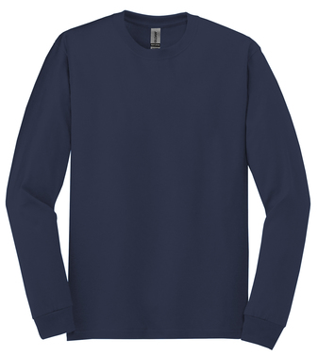
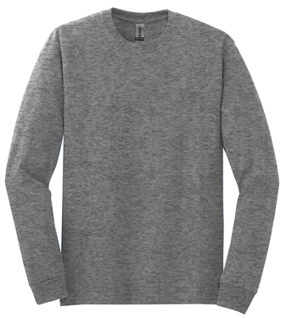
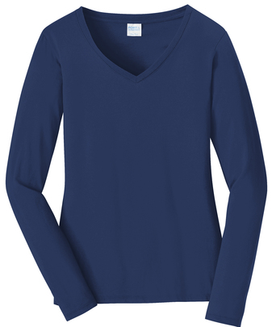
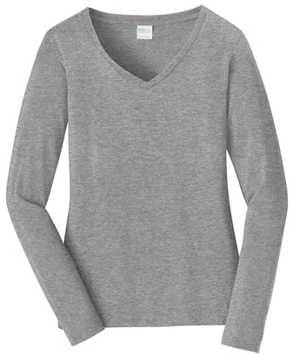
Norcross Spiritwear Order Form 2023- Items will be printed with the Norcross Soccer logo in white or navy depending on the garment color
Gildan® - Heavy Cotton™ 100% Cotton Long Sleeve T-Shirt- $16.00 each S-XL, $18.00- 2XL and $19.50- 3XL
5.3-ounce, 100% US cotton
50/50 cotton/poly- Graphite Heather
Non-topstitched, classic width, rib collar
Tearaway label
Taped neck and shoulders
Rib knit cuffs
Color: ___ Navy ____ Graphite Heather
Size: ____ S ____ M ____ L ____ XL ____ 2XL ____ 3XL
Port & Company® Ladies Long Sleeve Fan Favorite™ V-Neck Tee- $17.00 each S-XL, $19.50- 2XL and $20.50- 3XL
4.5-ounce, 100% ring spun cotton, 30 singles
90/10 cotton/poly (Athletic Heather)
Ladies fashion fit
Removable tag for comfort and relabeling
Rib knit collar
Shoulder to shoulder back neck taping
Embroidered
Color: ____ Team Navy ____ Athletic Heather
Size: ____ S ____ M ____ L ____ XL ____ 2XL ____ 3XL

Slide 5
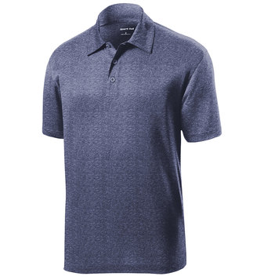
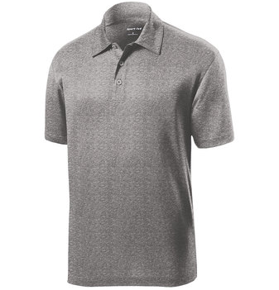
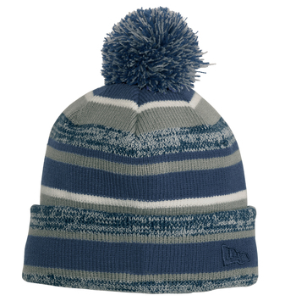
Norcross Spiritwear Order Form 2023- Item will be embroidered with the Norcross N and Blue Devil logo in white or navy depending on the garment color.
Sport-Tek Heather Contender Polo- $22.50 each XS-XL, $24.50- 2XL and $26.50 for 3XL
Moisture-wicking, snag-resistant polo.
3.8-ounce, 100% polyester jersey, Tag-free label, 3-button placket with dyed-to-match buttons, Set-in, open hem sleeves and Side vents
Color: ____ Heather Navy ____ Vintage Grey Heather
Size: ____ XS ____ S ____ M ____ L ___ XL ____ 2XL
New Era® Sideline Beanie- $22.00 each
Fabric: 100% acrylic shell
100% polyester fleece lining
Color: ____ Navy Stripe
Size: OSFM

Slide 6
Norcross Spiritwear Order Form 2023- Item will be embroidered with the Norcross N and Blue Devil logo in white or navy depending on the garment color.
Port Authority® Snapback Trucker Cap- $15.00 each
Fabric: 100% cotton twill front panels and bill (Solids); 65/35 polyester/cotton twill front panels and bill (Heathers); 100% polyester mesh mid and back panels
Structure: Structured
Profile: Mid
Closure: 7-position adjustable snapback
Color: ____ Navy/White ____ Navy/Grey Heather/ White
Size: OSFM
Port & Company® - Brushed Twill Low Profile Cap- $15.00 each
Fabric: 100% brushed cotton twill
Structure: Unstructured
Profile: Low
Panels: 6
Closure: Self-fabric slide closure
Color: ____ Navy
Size: OSFM

Slide 7
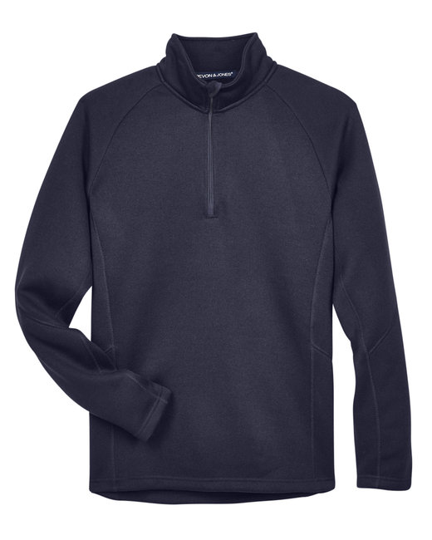
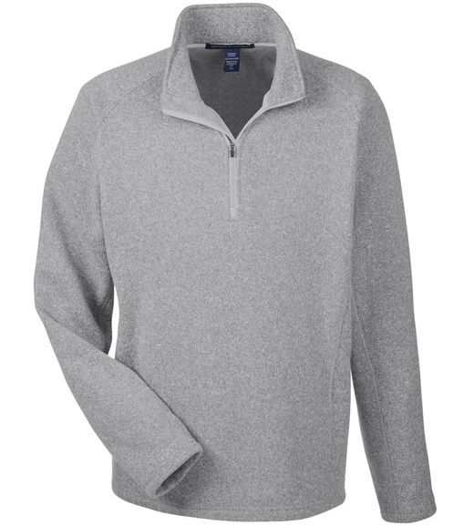
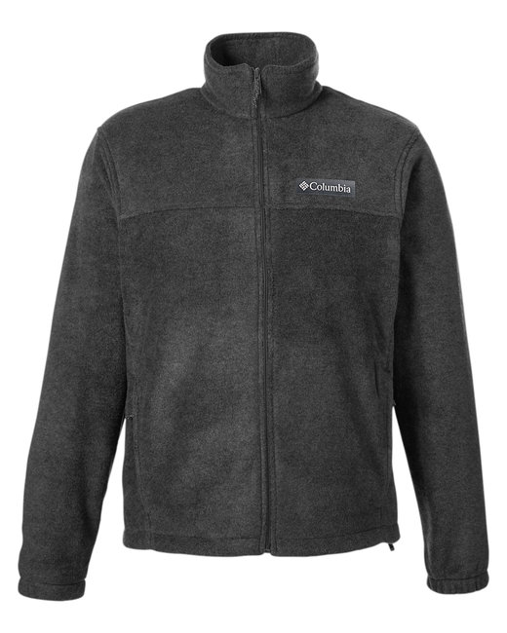
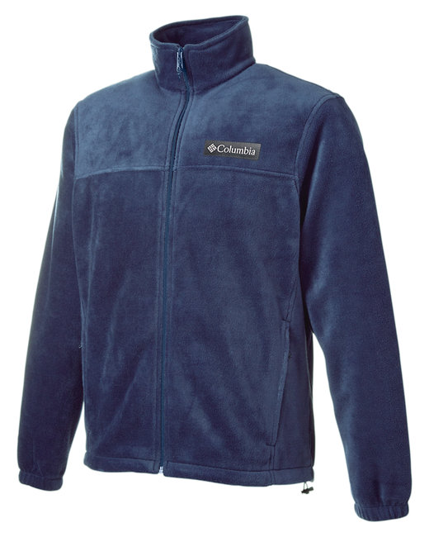
Norcross Spiritwear Order Form 2023- Item will be embroidered with the Norcross N and Blue Devil logo in white or navy depending on the garment color.
Devon & Jones Adult Bristol Sweater Fleece Quarter-Zip- $49.50 each S-XL, $51.50- 2XL and $53.50- 3XL
9.44 oz./yd² / 320 gsm, 100% polyester anti-pill sweater fleece
Inside storm placket with chinguard
Center front coil zipper with semi-autolock slider and rubber pull- Stretch binding at neck- Coverstitch details throughout
Raglan sleeves
Color: ____ Navy ____ Grey Heather
Size: ____ XS ____ S ____ M ____ L ____ XL ____ 2XL ____ 3XL
Columbia - Steens Mountain™ Full Zip Fleece- $59.00 each S-XL, $60.50- 2XL and $62.50- 3XL
7.4 oz./yd² (US) 12.3 oz./L yd (CA), 100% polyester MTR filament fleece
Elastic cuffs
Adjustable drawcord at bottom hem
Zippered hand pockets
Elevated patch logo on left chest
Color: ____ Charcoal Heather ____ Navy
Size: ____ S ____ M ____ L ____ XL ____ 2XL ____ 3XL

Slide 8
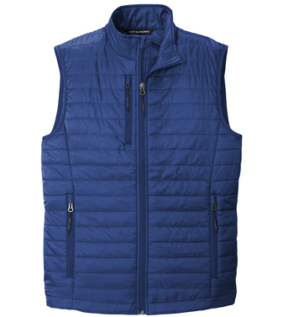
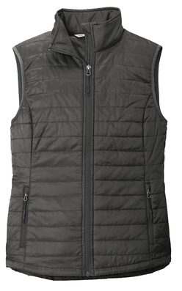
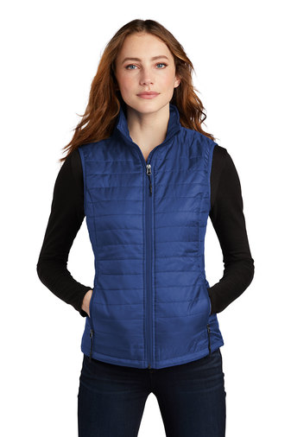
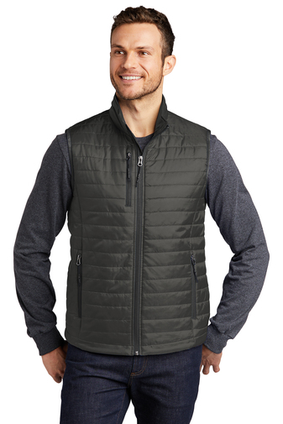
Norcross Spiritwear Order Form 2023- Item will be embroidered with the Norcross N and Blue Devil logo in white or navy depending on the garment color.
Port Authority®Packable Puffy Vest- $52.00 each XS-XL, $54.00- 2XL and $55.00 for 3XL
100% polyester shell and lining
2.4-ounce, 100% polyfill insulation
Front zippered pockets
Reverse coil zippers
Adjustable locking drawcord at hem
Port Pocket™ for easy embroidery access
Insulation method: 2.4-ounce polyfill
Water protection method: PU coating and water-repellent finish
Dyed-to-match drawstring carrying pouch included
____ Men’s ____ Women’s
Color: ____ Cobalt Blue ____ Sterling Grey
Size: ____ XS ____ S ____ M ____ L ____ XL ____ 2XL

Slide 9
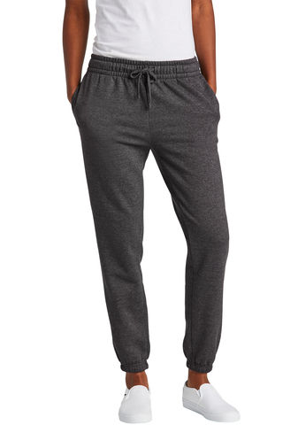
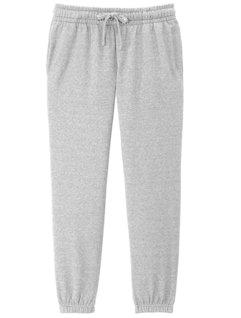
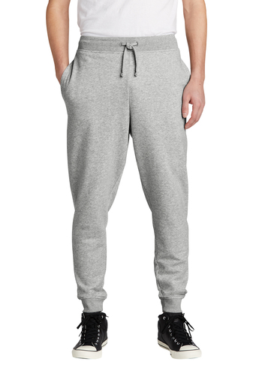
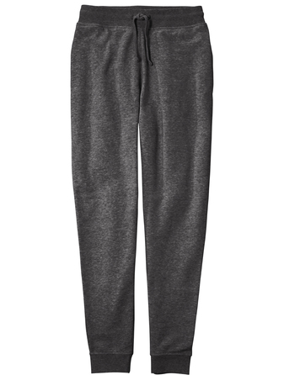
Norcross Spiritwear Order Form 2023- Item will be embroidered with the Norcross N and Blue Devil logo in white or navy depending on the garment color.
District® Women’s V.I.T.™ Fleece Sweatpant- $30.00 each S-XL, $31.50- 2XL and $33.00 for 3XL
100% ring spun cotton face (Solids, Light Heather Grey)
Dyed-to-match exterior drawcords
Self-fabric elastic waistband and cuffs
Side seam pockets- Side seamed- Tear-away label
Color: ____ Heather Charcoal ____ Light Grey Heather
Size: ____ XS ____ S ____ M ____ L ____ XL ____ 2XL ____ 3XL
District® V.I.T.™ Fleece Jogger- $30.00 each S-XL, $31.50- 2XL and $33.00 for 3XL
100% ring spun cotton face (Solids, Light Heather Grey)
Dyed-to-match exterior drawcords
Self-fabric elastic waistband and cuffs
Side seam pockets- Side seamed- Tear-away label
Color: ____ Heather Charcoal
____ Light Grey Heather
Size: ___ XS ___ S ___ M ___ L ___ XL ___ 2XL
___ 3XL

Slide 10
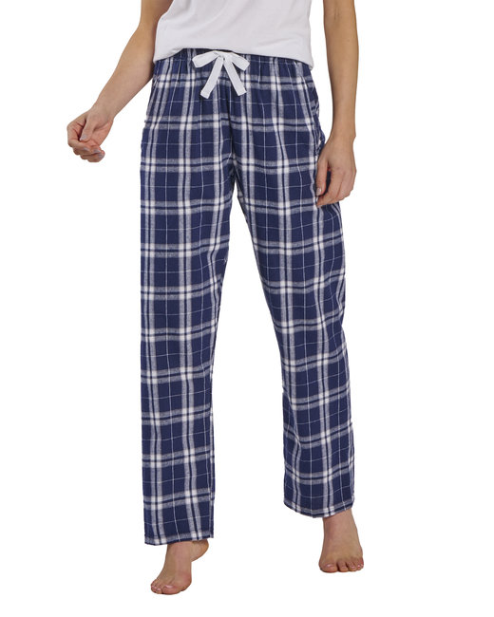
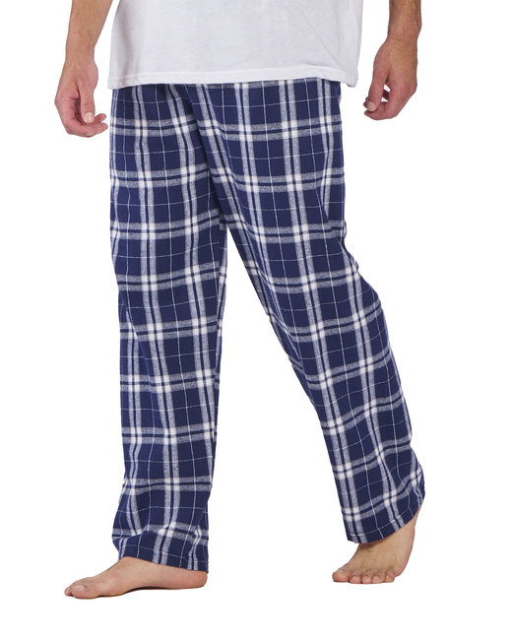
Norcross Spiritwear Order Form 2023- Item will be embroidered with the Norcross N and Blue Devil logo in white or navy depending on the garment color.
Boxercraft Flannel Pant with Pockets- $33.50 each S-2XL
Material:
4.3 oz., 100% cotton flannel
Feature:
Folded waist band
Exterior twill drawcord
Welt pockets with matching self-fabric pocket
___ Women’s ___ Men’s
Color: ___ Navy Plaid
Size: ___ XS ___ S ___ M ___ L ___ XL ___ 2XL

Slide 11
Norcross Spiritwear Order Form
Name _______________________________________
Contact Phone ________________________________
Contact Email _________________________________
Student’s Name _______________________________
Grade_______________________________________
Please email your completed form to Leah Bilz at leahbilz@yahoo.com no later than February 3rd. You can also turn in your form at the concession stand during home games on January 30th or February 1st.

